Slide 1

Year 11 Parent Information Evening
‘Parental support is eight times more important in determining a child’s academic success than social class. Parental involvement can make the difference between a grade 9 and a grade 3 at GCSE’.
The Times-The Campaign for Learning
8th September 2026

Slide 2

Mr Ravenscroft, Miss Lamey,
Mr Hetherington &
Mrs Knowles

Slide 3
Points discussed tonight
How have GCSE’s changed?
Careers advice
Our expectations of year 11 students
Key dates
Strategies to help your children
Revision techniques

Slide 4

School
Working Life
Retirement
• 420 weeks spent school; 29 school weeks left
• After this week there are only 28 more school Monday get ups! Until exams start
What your child does now shapes their opportunities for their working life.
Notes:
93% of the way through their compulsory school journey

Slide 5

GCSEs have got harder . . .
No /Less coursework
More challenging content – AS content now on the higher Maths GCSE and higher Science GCSE
Students are not allowed copies of the texts they have studied in their English Literature exam.
For 2025-27 students are not expected to memorise formulae for Science and Maths, however they should not become complacent.
Despite the impact of Covid, the current Year 11s will sit full exams with no additional information about what is on the exams.

Slide 6
Our expectations in Year 11
Exemplary attitude
Exemplary behaviour
100% effort
Exemplary attendance and punctuality
Engage fully with homework
Attendance at extra provision sessions

Slide 7
What makes a successful GCSE student?
They know why it is important to gain the best possible results in relation to the pathways they open.
They work hard.
They organise their time well.
They practise exam questions regularly.
They don’t give up when things get tough.

Slide 8
Mrs Knowles – Careers Adviser

Slide 9
Careers
Mrs Knowles – Career Co-ordinator and Adviser with over 25 years of experience
In school Full Time
1:1 guidance interviews / small group sessions
  Referrals: - targeted students, staff & self-referred
Interviews 30 minutes long –
  Discussion with your child about what they would like to do after Year 11
  Informal chat but an action plan is produced
  Signpost students to research different careers
  Start seeing in October as currently following up last year's leavers to ensure they are sorted

Slide 10
What are their Post 16 Options?
Apprenticeships / Traineeship
Job (with training)
Fairfax 6th Form
From
SCHOOL
Another 6th Form
UTC’s
  - A6thEA
  BOA
  WMG
  Shireland Biomedical
College
All students will be expected to make at least 3 applications
Plan A, B & C

Slide 11
What qualifications can you take
AFTER GCSE?
Level 3 Qualifications: - need to achieve at least 4 GCSES at grade 4 inc Eng & Maths
Alevels & Btecs or Tlevels or Apprenticeships
Here at Fairfax we offer: Alevel and Btecs
Alevels:
Linear and academic these are subject based subjects which provide opportunity to study topics more in depth.
BTEC
BTECs are vocational, work-related and mainly coursework based, designed to allow students to progress to higher education.
Level 3 BTECs are an alternative to A Levels and give you the relevant UCAS points to progress to higher education.
We offer Level 3 Extended Certificate which equals 1 Alevel

Slide 12
What students need to achieve?
For Fairfax 6th form
We are an ACADEMIC 6th form
5 GCSEs grades 4-9 including English and Maths.
Individual subjects often have higher entry criteria.
  -if you have not studied the subject before then a 5 in English/Maths is required
  - 6/7’s’s are required in a number of academic subjects – Sciences, Maths
  We DO NOT OFFER GCSE resits for those not achieving grade 4s in Eng or Maths
  Limited number of subjects for those who only achieve grade 4s

Slide 13
What students need to achieve?
For Fairfax 6th form
We are an ACADEMIC 6th form
We offer a Full A level Programme as well as BTEC qualifications which are equal to an Alevel.
BTEC qualifications still allow access to university.
Please see our website for the course listing
Apply for Fairfax Sixth Form – Fairfax Academy

Slide 14
What qualifications can you take
AFTER GCSE?
Level 3 Qualifications:
T Levels or Apprenticeships
Predominately offered at colleges and with employers
T Levels
Are a Level 3 vocational but academic qualification and are for young people under the age of 19.
They include a significant work placement to put learning into practice.
T Level you spend about 20% of your time in the workplace and 80% in college.
Apprenticeships
Opposite to Tlevels – you Earn and Learn
80% is spent in employment 20% is spent learning theory
Wide range of career areas on offer delivering apprenticeships. Levels 2 & 3 are relevant to Year 11 leavers.
To get onto a Level 3 programme students need at least 4 GCSEs at grade 4 to include Eng and Maths.
For a 6th forms entry is usually higher requiring 5 GCSES

Slide 15
What you need to achieve?
For Apprenticeships
  Different levels of apprenticeships available after Year 11 or Year 13
  Different durations of how long the apprenticeship last
  It is not necessarily ‘the easy option!’
Main Government website: www.apprenticeships.gov.uk
Degree | Level 5/6 | Foundation degrees/Degrees
Higher | Level 4 | HNC/HNDs
Advanced | Level 3 | A levels Tlevels or Btec L3
Intermediate | Level 2 | GCSEs 9-4s (A-Cs)
No apprenticeships Traineeship | Level 1 | GCSEs 3-1 ( D-Gs)

Slide 16

If Undecided
www.Unifrog.org
Unifrog is a one-stop-shop where students can easily explore their interests, then find and successfully apply for their next best step after school.
It can help with:
  being undecided by using the quizzes
  providing career information
  searching for courses at college or 6th forms
  Applying for apprenticeships
  Looking ahead for applying to university
  Compiling university lists
  Or studying abroad
Students can use SSO
through Microsoft to sign in

Slide 17
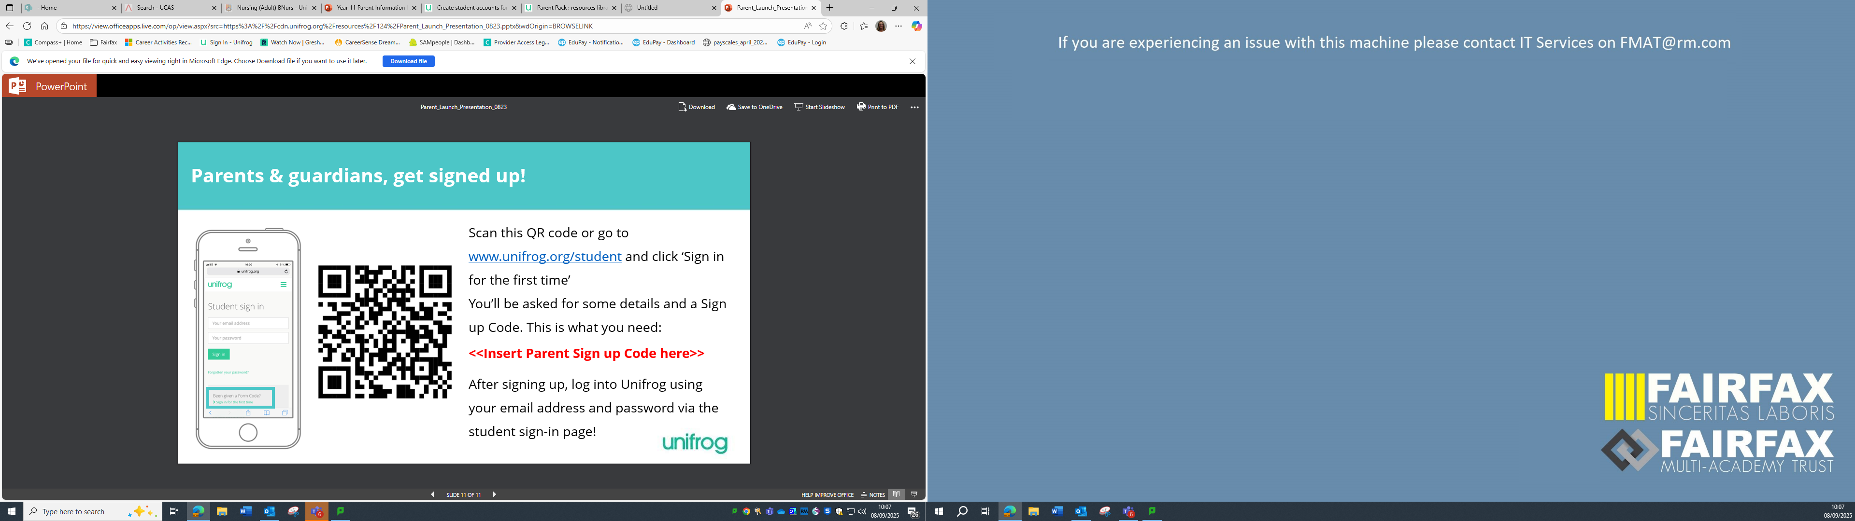
Parental Access
Parents can access their own account by using this code: FAFSparent​
You will need to complete the form to register or you can register using this link: https://www.unifrog.org/code and use the code above
You will not have access to your child's account however you will have access to:
A weekly newsletter
A summary of any shortlists your child has made
Details of any interactions made such as a 1:1 interview or a career event they have attended.

Slide 18
To help in decision making
Go to 6th form open evenings
  Fairfax 6th form open evening 24th November 2026
Go to college open evenings/days
Read around the subjects you are interested in taking
  What will you be studying?
  How is it assessed?
  Speak to tutors and find out more information
Apply to at least 3 places so you have a Back Up Plan in place.
A back up plan is lower in grade entry than your first choice

Slide 19
How can you get in touch?
You can refer your child for interview by emailing directly on
      FF-Careers@fairfax.fmat.co.uk
Students can:
  self-refer on the same email.
  Call in to see Mrs Knowles in the Library during lunch or break times
  Speak to their form tutor or head of year to be referred
  I try my hardest to get to see as many students as possible

Slide 20
Attendance
Parental
Support

Slide 21
ATTENDANCE
90% attendance over 5 years of secondary school = ½ a school year missed
17 missed school days a year = One GCSE grade DROP in achievement over all subjects.
The greater the attendance the greater the achievement.

Slide 22
Attendance | 7+ EngMa | 5+ EngMa | 4+ EngMa | Attainment 8
100% | 30.4% | 82.6% | 91.3% | 59.07
95 – 99% | 20.9% | 64.5% | 81.8% | 55.17
90 – 94% | 1.5% | 45.6% | 66.2% | 46.18
51 – 89% | 3.0% | 30.3% | 48.5% | 39.77
50% or below | 0.0% | 10.0% | 20.0% | 21.30
Our students with 95–99% attendance achieved, on average, almost one grade higher across their Attainment 8 subjects than those with 90–94% attendance.

Slide 23
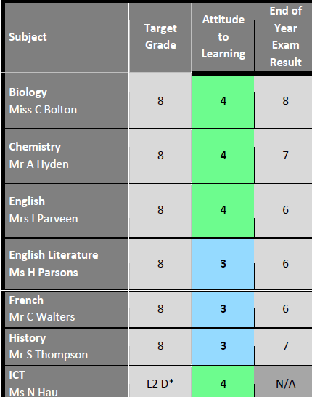
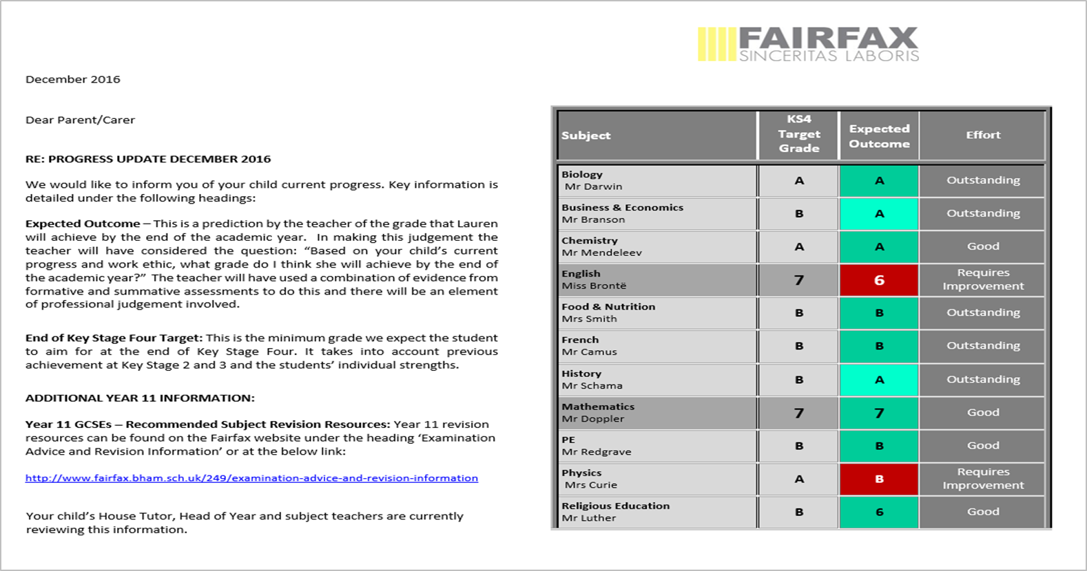
Keeping you informed about your child’s progress
Effort score has been replaced with Attitude to Learning

Slide 24

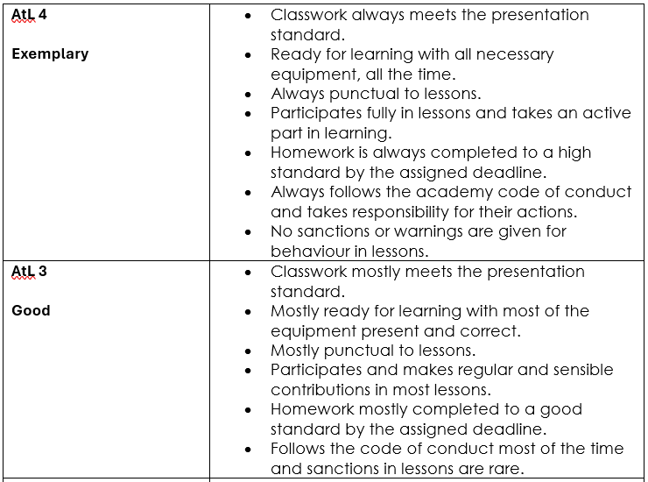
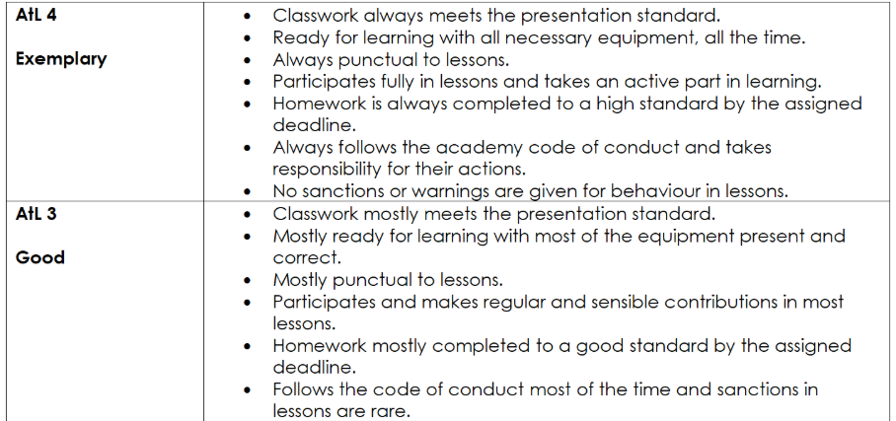

Slide 25
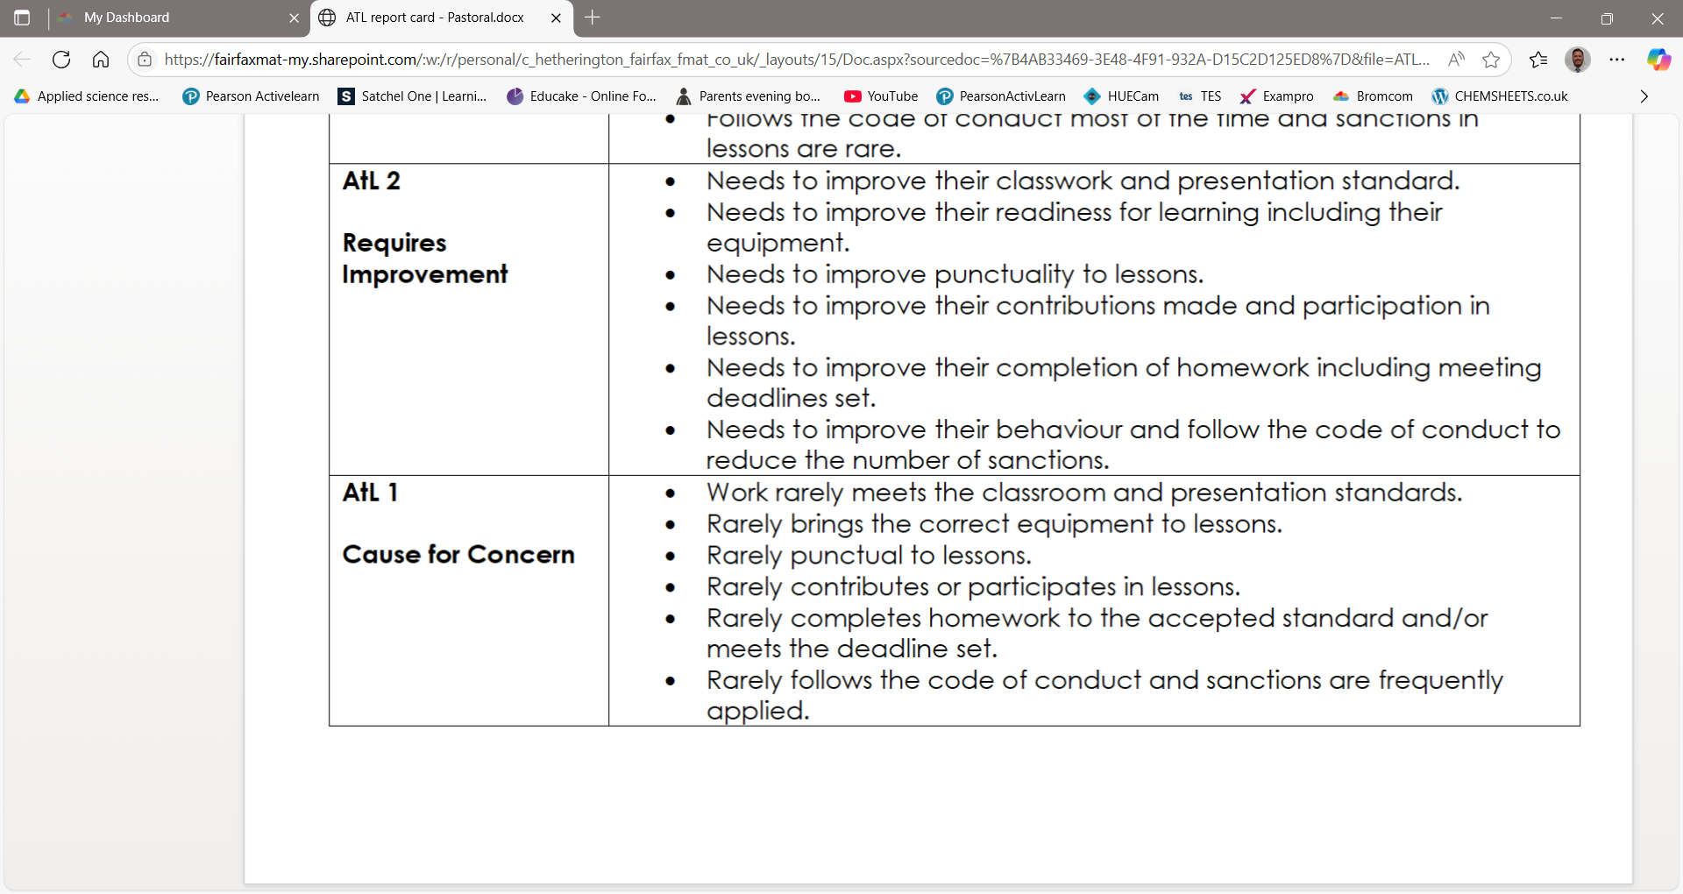

Slide 26
Key dates
8th September – Parent Information Evening 1
17th – 19th September- Silver D of E Practice Expedition Peak District
21st September - Intervention starts every Monday until November Mocks in form time
22nd September – Open evening. School closes at 13.25 & opens at 10am 23rd September
2nd October- Teacher training day
22nd October – Progress Reports Issued
2nd November – Y11 Mock Exams Window 1 Begins (2 weeks)
24th November – Sixth Form Open Evening
25th November – Sixth Form Online Application Opens
3rd December– Year 11 Mock Job Interviews throughout the day
16th and 17th December – The Eisteddfod
17th December – Progress Reports Issued
W/C 4th Jan – Creative iMedia exam will be sat. (students are aware)
12th January – Parent Information Evening 2 [English, Maths & Science Focus]
20th January – Y11 Parents Evening
8th February – Mock Exams Window 2 Begin (1 week either side of half term)
24th March – Progress Reports issued
10th May – GCSE Summer Exam Series Begins
24th June – Year 11 Prom

Slide 27
Prom - Thursday 24th June 2026 at Aston Wood Golf Club
Students earn their invite to prom
We look at:
  Attendance – is it above 95%
  Behaviour – no suspensions, no more than 25 negs, lots of positives and regular attendance to intervention sessions.
Notes:
16 students were not invited last year due to poor attitude to school / learning
94% eligible and invited
75% of 2025 cohort attended

Slide 28


What can you do to support?
Support them in deciding their future plans
Ensure at school and on time
Help ensure deadlines are met
Help with study plan/routine
Provide the right learning environment
Ensure a balanced diet and sleep
Keep a check on what they are doing
Reduce social time
Ensure revising and doing homework

Slide 29
You may be asking yourselves the following questions:
When should my son/daughter start revising?
How much revision should they be doing?
What should they be revising and how should they be completing their revision?
How can I help as a parent?

Slide 30
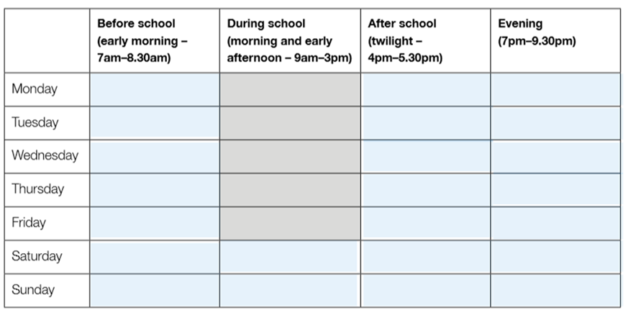
Students can start revising now but the amount of revision they do should gradually increase as they get closer to their exams.
They will also have homework to complete alongside their revision in the first few months of Year 11.
Please do not jump to completing hours worth of revision. Maximum amount this early is 1 hour a night. I suggest 20 minutes a night for the next two/three weeks, then 40 minutes, then 60 minutes etc.

Slide 31
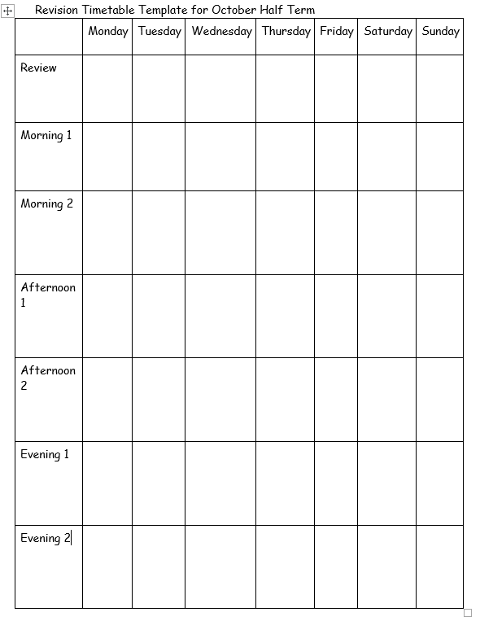
Revision does not stop over the half term break either.
Dedicate time throughout the day to revision and stick to it, do not find an excuse not to do it. Be specific.
You must make sure that you also have time to relax as well.

Slide 32
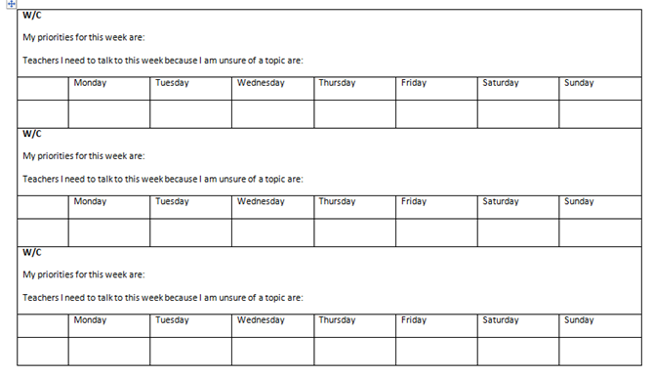
Closer to the exam during term time . . .

Slide 33
Most students will not be able to properly focus on a topic for more than 20/25 minutes at a time.
It is also very important that they have a break if they are revising more than one subject in a row.
If your child is doing a 1 hour revision session for a subject then it should include 20 minutes of focused revision and then a 5 minute break followed by a 5 minute review of learning. Then another 20 minutes of focused revision etc etc

Slide 34
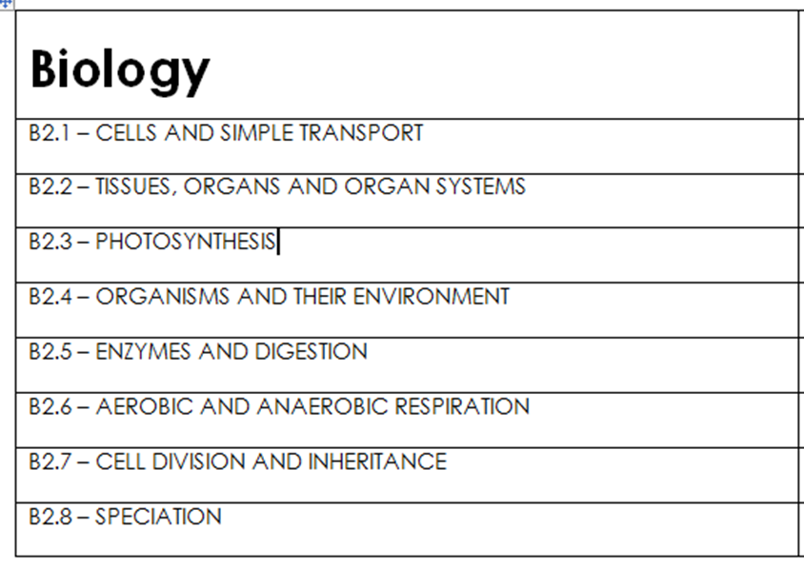
How should your child decide what they should revise?
They should get a topic lists.
This will ensure they revise everything that could possibly come up on the exam.
Topic lists can be found on exam board websites or teacher can provide topic lists for students.

Slide 35
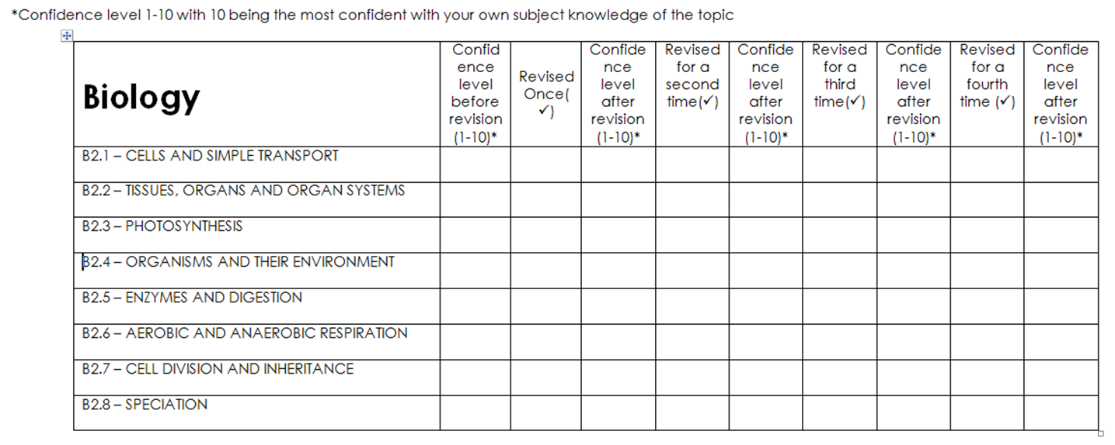
How should your child decide what they should revise?

Slide 36
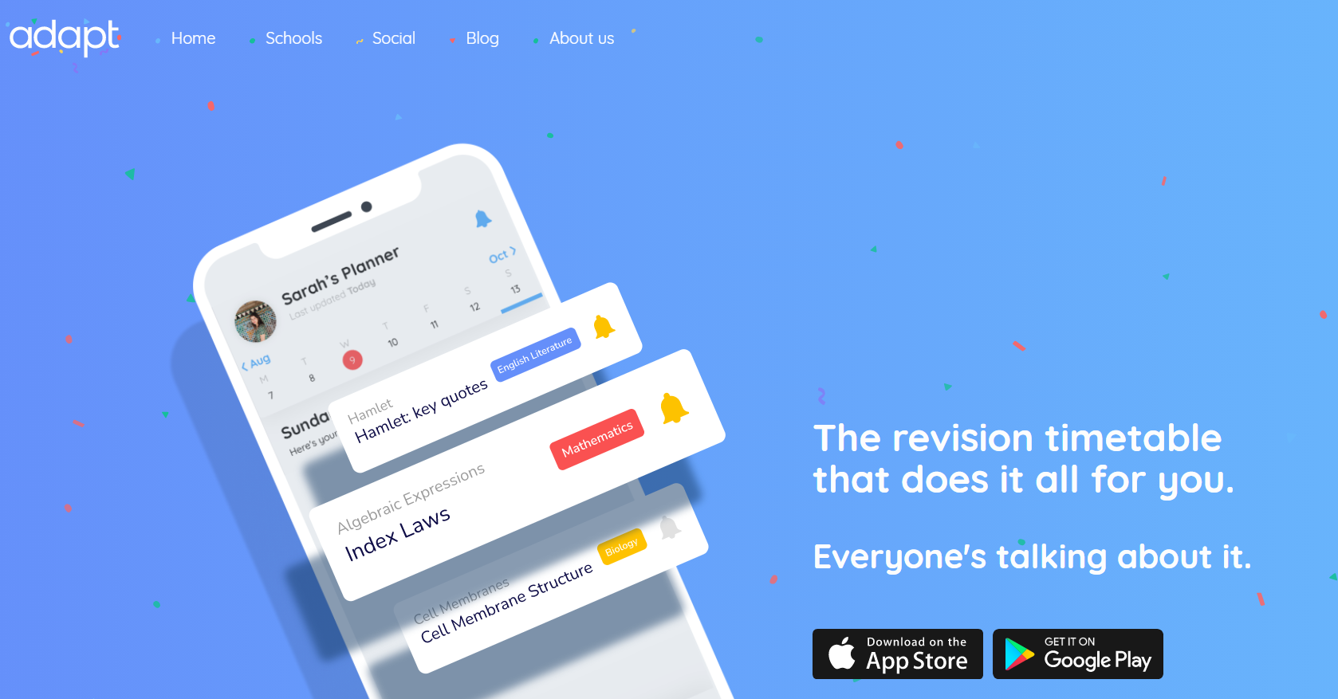
Adapt – Free Revision Timetable App

Slide 37
Make sure your child uses revision strategies that actually work
Too many people think that simply reading through their notes is effective revision.
Unfortunately, it isn’t. Mainly because your brain doesn’t have to think too much while you do it.
The next few slides suggest some revision strategies/techniques that do actually work.

Slide 38

Condense Your Notes
One of the best things that students can do is to try and condense their notes.
You should be trying to reduce the information in your work book or textbook into just the key points.

Slide 39
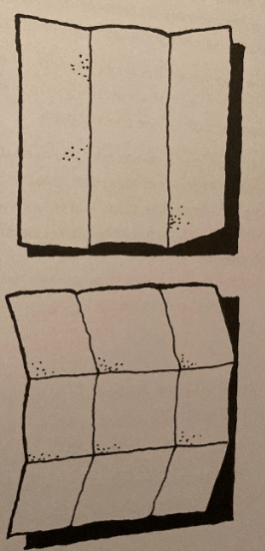
The 9 Box Grid
All you need is a sheet of A4 paper.
Place the paper in front of you – landscape – fold it into thirds.
Then with it folded, do it again the other way so that you get nine squares.
You now need to summarise an entire topic in 9 boxes.
  First, read through your notes and decide the headings for each box. What are the 9 most important things from the topic.
  Now write the key information under each heading – remember you only have a small box, only the key points can be included. Use diagrams and pictures.
  Now regularly read through the sheet to remind yourself of the topic.
You could also use this template to turn a topic or key event/process into a storyboard/cartoon strip.

Slide 40
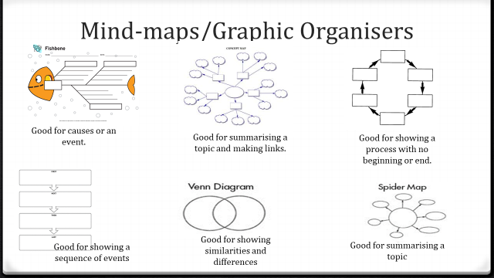
Mind-maps/Graphic Organisers
Use a black or blue pen to write down all the information you can remember on a topic on your graphic organiser on a topic, without using your books.
Using your books and revision material, amend any mistakes with a red pen.
Using your books and revision material, add anything you have missed with a green pen.
Repeat the process again in 3 days, and then 3 weeks . . . Repeat, Repeat, Repeat

Slide 41

Flash Cards
These can be used in a range of ways:
  To summarise a topic or event within a topic.
  Question one side, answer the other so you can test yourself.
  Keyword one side, definition the other so you can test yourself.
Post-it notes are also a good way of doing Questions and Answers for topics. Stick them up in your room and test yourself regularly.

Slide 42
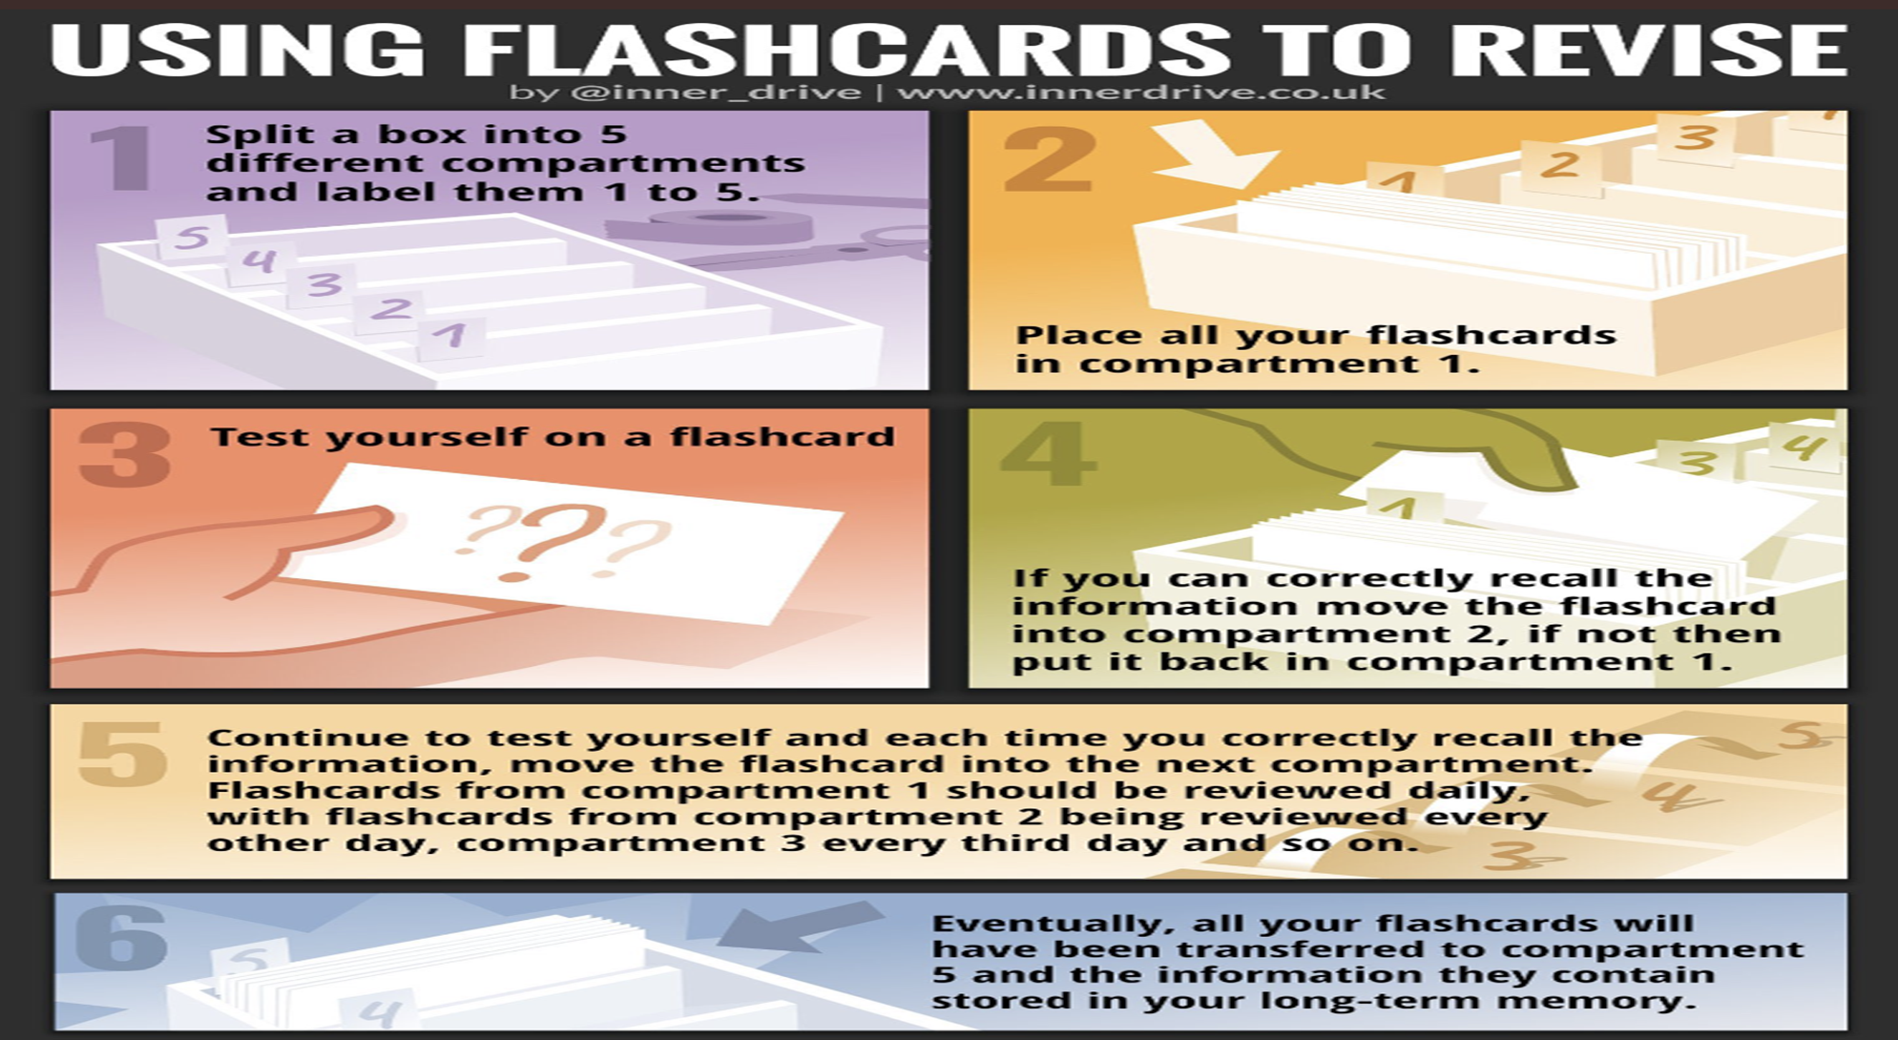

Slide 43


Make sure they are testing themselves so they know if their revision has worked
This is the most important thing that needs to be done.
Research has proven that without regular testing revision does not work.
The day or a few days after revision your child should have some way to test themselves
They should try and complete past exam questions in timed conditions or knowledge tests without notes.

Slide 44

Using Artificial Intelligence (AI) such as ChatGPT
Create and Mark Practice Exam Questions
AI tools can generate tailored exam-style questions for any GCSE subject, then mark student answers and provide instant, constructive feedback — helping students identify gaps and improve their exam technique.
Explain Difficult Concepts in Simple Terms
Students can ask AI to break down complex topics into more understandable language, get step-by-step explanations, or even receive summaries of key ideas — ideal for revisiting tricky areas or preparing for assessments.
Build Personalised Revision Plans
AI can help students organise their time by creating customised revision timetables based on their subjects, strengths, and exam dates — promoting consistency and reducing last-minute cramming

Slide 45
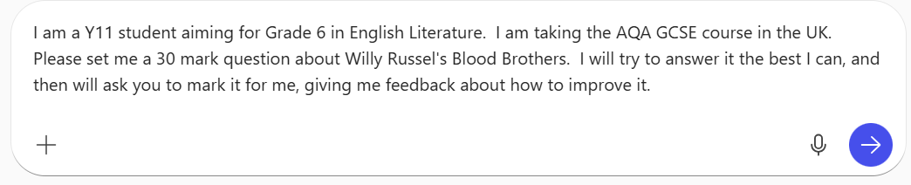
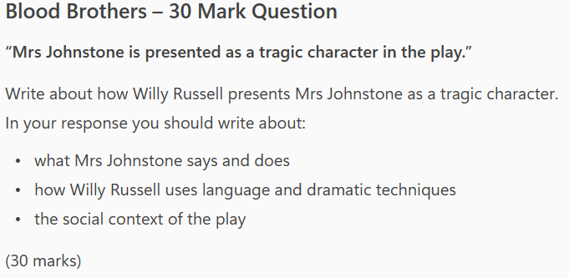
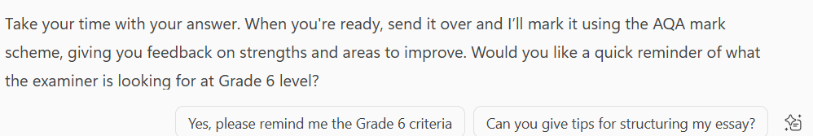

Slide 46
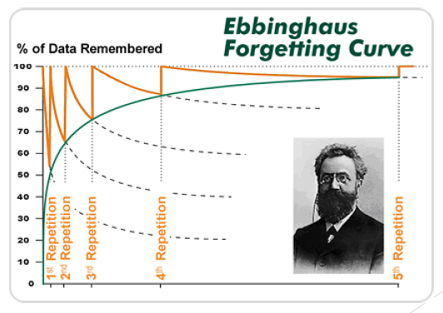
Encourage your child to revise things more than once
Research suggests that you need to revise a topic four times before you truly understand it and memorise it.
Make sure that you revise every topic more than once in the run up to your exam.

Slide 47
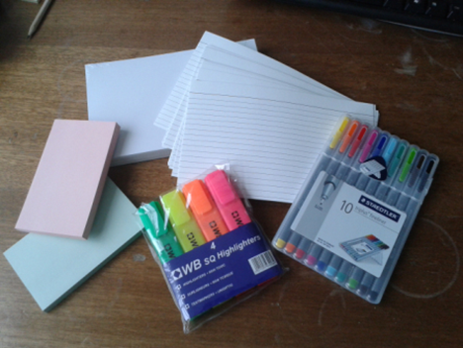
You can help your child by making sure they have all the resources they need for revision
There are a number of different resources that would be useful the main ones are:
  Work books for each subject
  Text book or revision guide
  Coloured pens/Highlighters
  Paper/ post it notes/ flash cards
  Revision websites

Slide 48
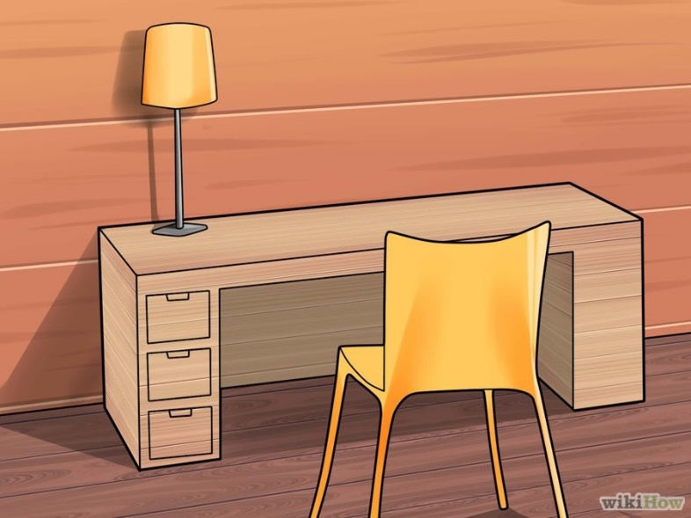
They also need a good quiet place to study
Students need to find a quiet, well lit place to study which is away from distractions.
They should log out of, or temporarily disable social media like Instagram, Snapchat, Tik Tok…

Slide 49
Extra provision
Weekly sessions in each subject.
Opportunity to improve knowledge and understanding.
Opportunity to improve controlled assessment work.
Opportunity to seek help with all aspects of work.
Please encourage your son / daughter to attend, they make a significant difference to achievement and progress.

Slide 50

Some of our students might be feeling like this . . .

Slide 51
Some easy ways to lower stress
Get plenty of sleep – turn off phones and consoles
No caffeine after 4pm (Pepsi 10 mg per 100ml, Diet Coke & Lucozade – 12mg, Red Bull/Energy Drink 30 mg)
Exercise

Slide 52
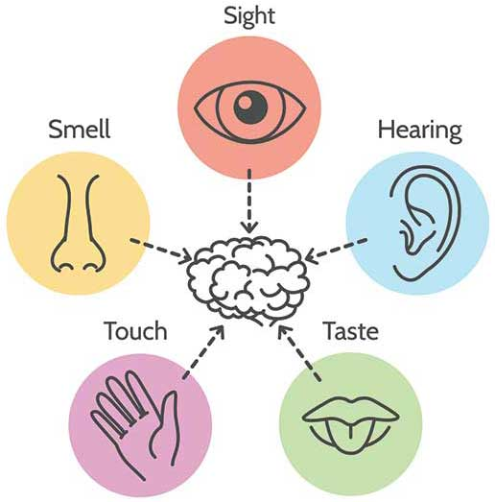
5 Senses
The aim of this technique is to stop your mind wandering off into the past or future and worrying about things that aren’t currently happening in the present moment.
When that ‘alarm’ is going off and you feel anxious try and sit still for a moment and notice your 5 senses
What can I:
  See
  Smell
  Hear
  Feel
  Taste

Slide 53
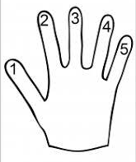
Five Finger Touch
Number the fingers on your hand 1-5
Then choose a target finger on the other hand and touch it with each numbered finger.
Then repeat for all the other fingers on your hand.
If it becomes too easy, then change the pattern (i.e. 1, 4, 3, 5, 2).
The trick is that the task should not be that difficult so it frustrates you but hard enough so that you have to think about it.

Slide 54
Listen to your worries
Write all your anxieties and worries down. Then draw two circles one inside of the other
Review each worry and ask yourself ‘What control do I have over this?’
If there’s something you can do to control the outcome of the worry, put it in the centre circle. If there’s nothing you can do to control the outcome of the thought or worry it goes in the outer circle.
People who handle stress well focus on spend their energy focusing on the worries they can control.
Things I can control
Things I have no control over

Slide 55
Faculty Contacts
  English and MFL – Mrs K Ford
  k.ford@fairfax.fmat.co.uk
  Maths – Mrs A Ashton
  a.ashton@fairfax.fmat.co.uk
  Science – Mr Hyden
  a.hyden@fairfax.fmat.co.uk
  Humanities – Mrs Maciewicz
  s.mackiewicz@fairfax.fmat.co.uk
  Business and Computing – Mr B Hewitt
  b.hewitt@fairfax.fmat.co.uk
  PE and Performance – Mr D Trowman
  d.trowman@fairfax.fmat.co.uk
  ART & Technology - Mrs A Bradnick
  a.bradnick@fairfax.fmat.co.uk

Slide 56
Key contacts
Mr Ravenscroft (Head of Year 11)
  c.ravenscroft@fairfax.fmat.co.uk
Miss Lamey (Assistant Head of Year 11)
  b.lamey@fairfax.fmat.co.uk
Mrs Knowles (Career Adviser)
  p.knowles@fairfax.fmat.co.uk
Mr Hetherington (Vice Principal)
  c.hetherington@fairfax.fmat.co.uk

Slide 57
Form Tutor Contacts
11XC- Mr Jolaosho: d.jolaosho@fairfax.fmat.co.uk
11XK-Miss Harvey: k.harvey@fairfax.fmat.co.uk
11XS- Ms Paris: j.paris@fairfax.fmat.co.uk
11XW- Mr Belikau: a.belikau@fairfax.fmat.co.uk
11FC- Ms Jones: k.jones@fairfax.fmat.co.uk
11FK- Miss Carty: k.carty@fairfax.fmat.co.uk
11FS- Ms Hussain: t.hussain@fairfax.fmat.co.uk
11FW- Mr Bradnick: s.bradnick@fairfax.fmat.co.uk

