Slide 1

Maintaining good well-being whilst in lockdown
Secondary: Week 5 - Sleep

Slide 2

Sleep and the links to well-being

Slide 3


Researchers at the University of Warwick have found that the amount of sleep you get can affect:
Our Mood
How anxious we feel
How impulsively we act
Our academic achievements

Slide 4

The recommended amount of sleep for children and young people is:
aged between 6 to 13 years: 9-11 hours
aged between 14-17 years : 8-10 hours.
(Source: sleepfoundation.org)

Slide 5
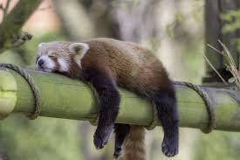
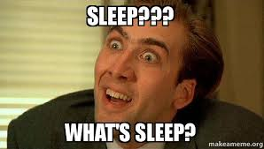
What disrupts our sleep?
Caffeine (Tea, Coffee, Cola)
Energy Drinks
Stress or anxiety
Alcohol
The light from electronic devices
If the room is too hot or too bright

Slide 6


Social media and gaming helps us to connect with friends and is a crucial part of everyday life.
However, sometimes the fear of missing out on what is going on might mean that you are tempted to access them when you would normally be asleep.

Slide 7

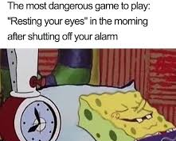
Top Tips for good sleep
According to the Sleep Foundation here are some top tips for a good night’s sleep:
Go to bed and wake up at the same time every day
Following a steady routine before bed, including time to unwind and relax
Avoiding big meals or excessive caffeine an hour or two before bed
Reduce use of electronic devices and activate the ‘blue light’ filter
Get outside or open curtains/blinds to get daily light
Find time to be physically active every day

Slide 8
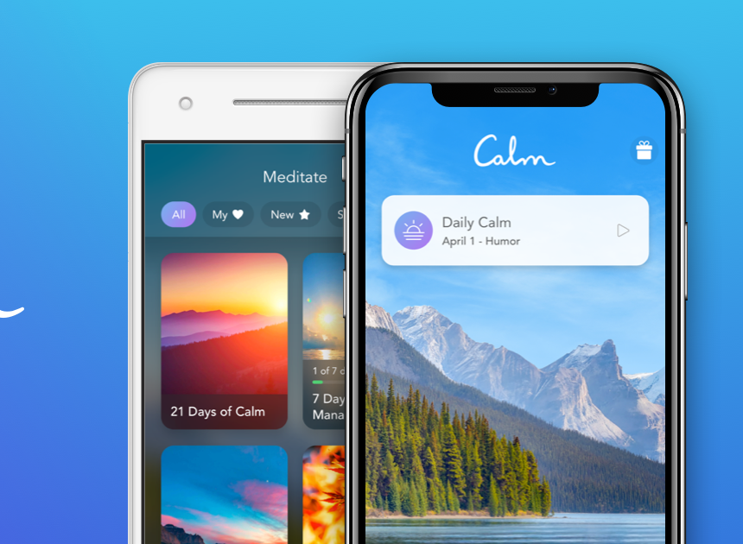


Apps and websites which could help!
Listening to waves crashing
https://www.youtube.com/watch?v=Ik17RkuGPmY

Slide 9

Take Care of yourself too!
It is really normal right now to be feeling lots of different feelings about what may be happening around you. Sometimes though, everyone needs a bit more help. For more help, advice and support don’t be afraid to contact: https://www.forwardthinkingbirmingham.org.uk/

Slide 10
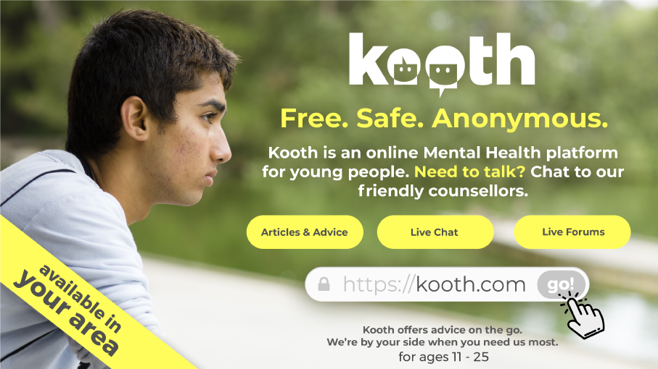

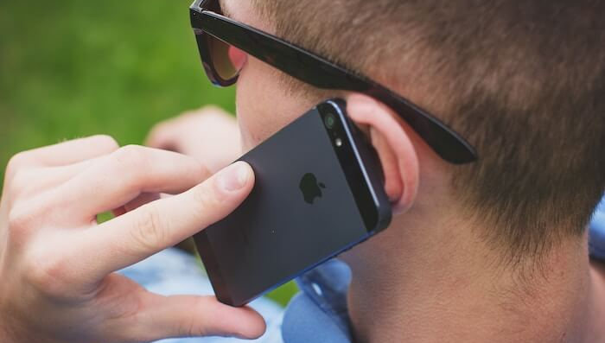
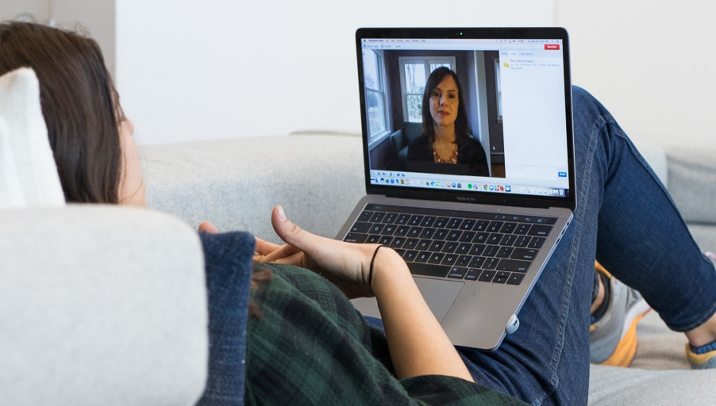

Kooth
Kooth is a safe, confidential and anonymous way for you to access emotional wellbeing and mental health support. It is widely used across the country and is well rated by other young people. It is free for you to use. Check it out here:
http://www.kooth.com/

Slide 11



Useful Organisations
Pause is here for you, if you are under 25 and have a Birmingham GP. We offer a non-judgemental listening ear, self-help strategies plus skills for managing difficult situations and feelings. We are open 10am-6pm, seven days a week.
Drop us an email on askbeam@childrenssociety.org.uk or call 0207 8414470 and we will arrange for one of our friendly team to call you back.
For more info check out https://www.forwardthinkingbirmingham.org.uk/
https://www.nhs.uk/oneyou/every-mind-matters/anxiety/
https://www.myh.org.uk/helpline

